Slide 1
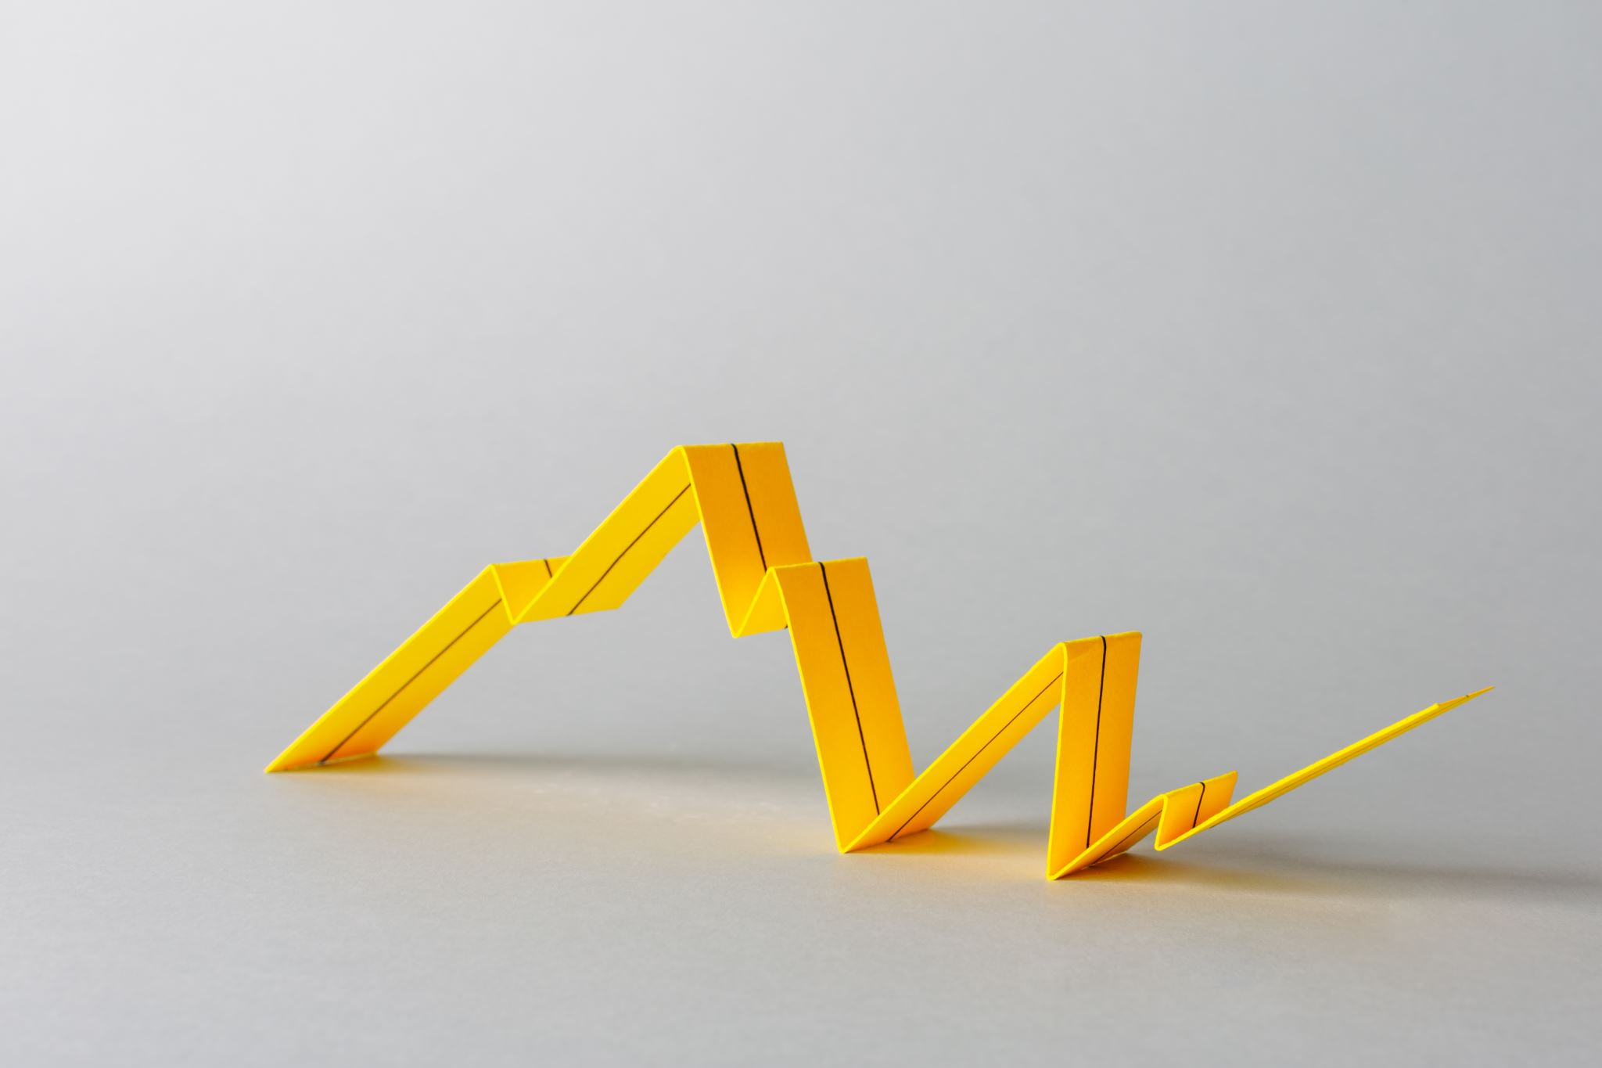
Economic Growth
Professor Syed A. Mamun, PhD, FCMA

Slide 2

Four Main Sources of Growth in Potential GDP:
1. Growth in Labour Supply
  An increase in the quantity of labor allows the economy to produce more goods and services.
Sources include:
  Population growth
  Higher labor-force participation
  Immigration
  Longer working hours
Example: If the labor force increases from 80 million to 84 million workers, firms can produce more output, increasing potential GDP.

Slide 3
2. Growth in Human Capital
Human capital refers to workers' knowledge, skills, education, training, and health.
Better-trained workers are more productive and can produce more output using the same amount of resources.
Examples:
  University education
  Technical and vocational training
  Digital skills development
  Improved healthcare
Impact:
Higher productivity → Higher potential GDP.

Slide 4
3. Capital Accumulation
Capital accumulation occurs when businesses invest in:
Machinery
Factories
Roads
Ports
Computers
Communication networks
Greater capital per worker increases productivity and expands productive capacity.
Example: A garment factory installs automated sewing machines, enabling workers to produce twice as many garments each day.

Slide 5
4. Technological Progress
Technology is the most important long-run driver of potential GDP growth.
Technological progress enables firms to produce more output from the same quantities of labor and capital.
Examples
Artificial intelligence (AI)
Robotics
Cloud computing
Renewable energy technologies
Precision agriculture
Impact
More efficient production lowers costs and raises the economy's sustainable output.

Slide 6
Economic Growth Theories

Slide 7
Evolution of Growth Theory
Classical Theory
↓
Growth limited by land and population
↓
Neoclassical Theory
↓
Growth through capital, labor, and exogenous technology
↓
New Growth Theory
↓
Growth driven by innovation, human capital, and knowledge

Slide 8
Classical Growth Theory
The Classical Growth Theory was developed by classical economists during the late 18th and early 19th centuries.
Major Contributors
Adam Smith
Thomas Robert Malthus
David Ricardo
John Stuart Mill
The theory argues that economic growth is temporary because population growth eventually outpaces increases in food production and other resources.

Slide 9
Classical Growth Theory: Basic Assumptions
Land is fixed in supply.
Population grows when incomes rise.
Capital accumulation increases output.
Diminishing returns to land eventually occur.
Technological progress is slow.

Slide 10
Malthusian Population Theory
According to Malthus,
  Population grows geometrically (2, 4, 8, 16...)
  Food production grows arithmetically (2, 4, 6, 8...)
Eventually,
  Population > Food Supply
This leads to:
  Poverty
  Famine
  Disease
  Lower wages
  Slower economic growth

Slide 11
Ricardo's Law of Diminishing Returns
As more labor and capital are applied to a fixed amount of land:
  Output increases.
  Productivity eventually falls.
  Production costs rise.
  Economic growth slows.

Slide 12
Classical Growth Process
Capital accumulation
↓
Higher output
↓
Higher wages
↓
Population growth
↓
More labor on fixed land
↓
Diminishing returns
↓
Falling productivity
↓
Economic stagnation

Slide 13
Stationary State
The classical economists believed that economies eventually reach a stationary state, where:
  Investment = Depreciation
  Population stops increasing
  Wages remain at subsistence level
  Per capita income no longer grows

Slide 14
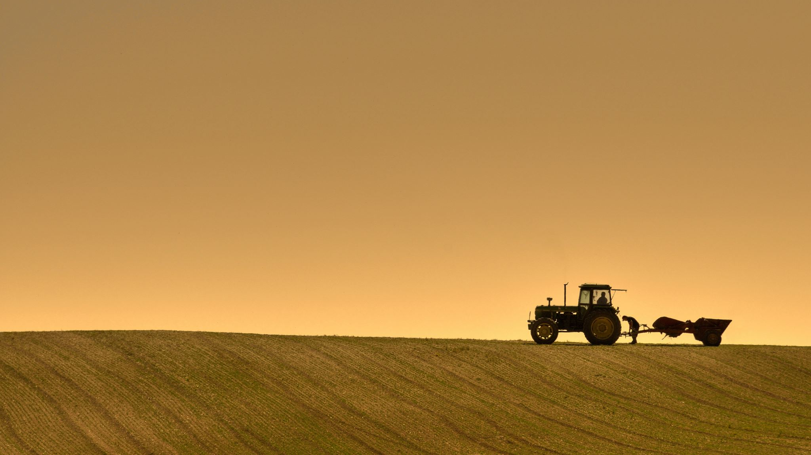
Discussion Questions
A country has the following characteristics
Population grows by 2.5% per year.
Agricultural land remains fixed.
Investment only replaces depreciated machinery.
There is almost no technological innovation.
Real GDP grows by 2.4% per year.
Questions
Is this country approaching a stationary state?
Which assumptions of Classical Growth Theory apply?
What policies could help the country escape the stationary state?

Slide 15
Strengths and Weaknesses of CGT
Strengths
  Highlights scarcity of natural resources.
  Recognizes diminishing returns.
  Explains historical pre-industrial growth patterns.
Weaknesses
  Underestimates technological progress.
  Assumes land is the primary constraint.
  Cannot explain sustained modern economic growth.
  Ignores improvements in education and innovation.

Slide 16
Neoclassical Growth Theory (Solow Growth Model)
The Neoclassical Growth Theory was developed in the 1950s.
Main Contributor
  Robert Solow
The model explains economic growth through:
  Capital accumulation
  Labor force growth
  Technological progress
  Technology is treated as exogenous (coming from outside the economic system).

Slide 17
Main Assumptions
Competitive markets
Constant returns to scale
Diminishing returns to capital
Savings finance investment
Technology improves over time
Full employment in the long run

Slide 18
Diminishing Returns to Capital
Initially,
  Adding more machines greatly increases production.
Eventually,
  Each additional machine contributes less additional output.
Therefore,
  Capital alone cannot sustain long-run growth.

Slide 19

Steady-State Growth
In the Solow model, the economy reaches a steady state when investment just offsets depreciation and the capital needed for population and technology growth. At this point, capital per worker remains constant. Long-run growth in output per worker comes primarily from technological progress.
Policy Implications
  Governments should:
  Encourage saving
  Promote investment
  Improve infrastructure
  Invest in education
  Support technological development

Slide 20
Strengths and Weaknesses of NCGT
Strengths
Explains convergence among countries with similar institutions.
Demonstrates the importance of savings and investment.
Highlights the central role of technological progress.
Weaknesses
Does not explain where technological progress comes from.
Treats technology as external to the economy.
Gives limited attention to knowledge creation and innovation incentives.

Slide 21
New Growth Theory (Endogenous Growth Theory)
The theory argues that technological progress is endogenous—it results from deliberate investment in research, education, innovation, and knowledge.
Major Contributors
  Paul Romer
  Robert Lucas Jr.

Slide 22
Main Assumptions
Knowledge creates positive spillovers.
Human capital is a key source of growth.
Innovation results from purposeful investment.
Increasing returns may occur in knowledge-intensive industries.

Slide 23
Main Drivers of Growth
Human Capital
Research and Development (R&D)
Innovation
Knowledge Spillovers
Increasing Returns

Slide 24
Policy Implications
Governments should:
  Increase education spending
  Encourage innovation
  Protect intellectual property
  Support universities and research institutions
  Promote entrepreneurship
  Invest in digital infrastructure

Slide 25
Strengths and Weaknesses of NGT
Strengths
Explains sustained long-run growth.
Recognizes innovation and knowledge as engines of growth.
Reflects the realities of modern, technology-driven economies.
Weaknesses
Difficult to measure knowledge spillovers.
Some assumptions are hard to test empirically.
May overemphasize the role of technology relative to institutions and other factors.

Slide 26
Comparison of Growth Theories
Feature | Classical Theory | Neoclassical Theory | New Growth Theory
Main Economists | Smith, Malthus, Ricardo | Robert Solow | Paul Romer, Robert Lucas Jr.
Time Period | 18th–19th Century | 1950s | 1980s onward
Main Driver | Capital and land | Capital, labor, technology | Innovation, knowledge, human capital
Technology | Slow or ignored | Exogenous | Endogenous
Returns to Capital | Diminishing | Diminishing | Can exhibit increasing returns through knowledge
Long-Run Growth | Ends in a stationary state | Sustained by technological progress | Sustained by innovation and knowledge creation
Role of Government | Limited | Promote savings and investment | Promote education, R&D, innovation, and institutions

Slide 27
Examples of Countries Consistent with the Three Growth Models
Growth Theory | Main Characteristics | Country Examples | Why They Fit the Model
Classical Growth Theory | Growth constrained by land, natural resources, and population; diminishing returns | Pre-industrial England, Ethiopia (historically), Niger, Chad | Rapid population growth, dependence on agriculture, limited technological progress, low productivity
Neoclassical Growth Theory (Solow Model) | Growth through capital accumulation, labor force growth, and exogenous technological progress | China (1980–2015), Malaysia, Vietnam, Thailand | High investment rates, infrastructure development, labor-force expansion, and adoption of existing technologies
New (Endogenous) Growth Theory | Growth driven by innovation, research and development (R&D), education, human capital, and knowledge | United States, South Korea, Japan, Finland, Israel, Singapore | Large investments in education, R&D, innovation, advanced technology, and knowledge-based industries
Notes:
No country perfectly fits a single growth theory. However, economists often use real-world examples to illustrate how each model best explains the dominant growth pattern of certain countries during particular periods.

Slide 28
"China experienced rapid growth through capital accumulation and technology adoption during 1980–2015, but today it is investing heavily in innovation and advanced technology. Does this mean China has transitioned from the Neoclassical Growth Model toward the New Growth Theory? Discuss with supporting evidence."
Group Discussion

